Slide 1


Exploratory Analysis of Data for Supermarket 2Market
hggccc
The demographics of customers
Which advertising channels seem to be the most effective
Which products seem to sell the best and if that varies based on demographic
Notes:
Hello everyone, my name is JC. Today, I'll be presenting an exploratory analysis of data for Supermarket 2Market.
I'll be focusing on three key business questions provided by new stakeholders:
The demographics of the customers
The effectiveness of advertising channels
The popularity of products and how it varies by demographic group
Additionally, given 2Market's dual operations, I felt it was important to understand the split between online and in-store business performance.
All three dashboards intend to provide broader view of existing data above all else

Slide 2
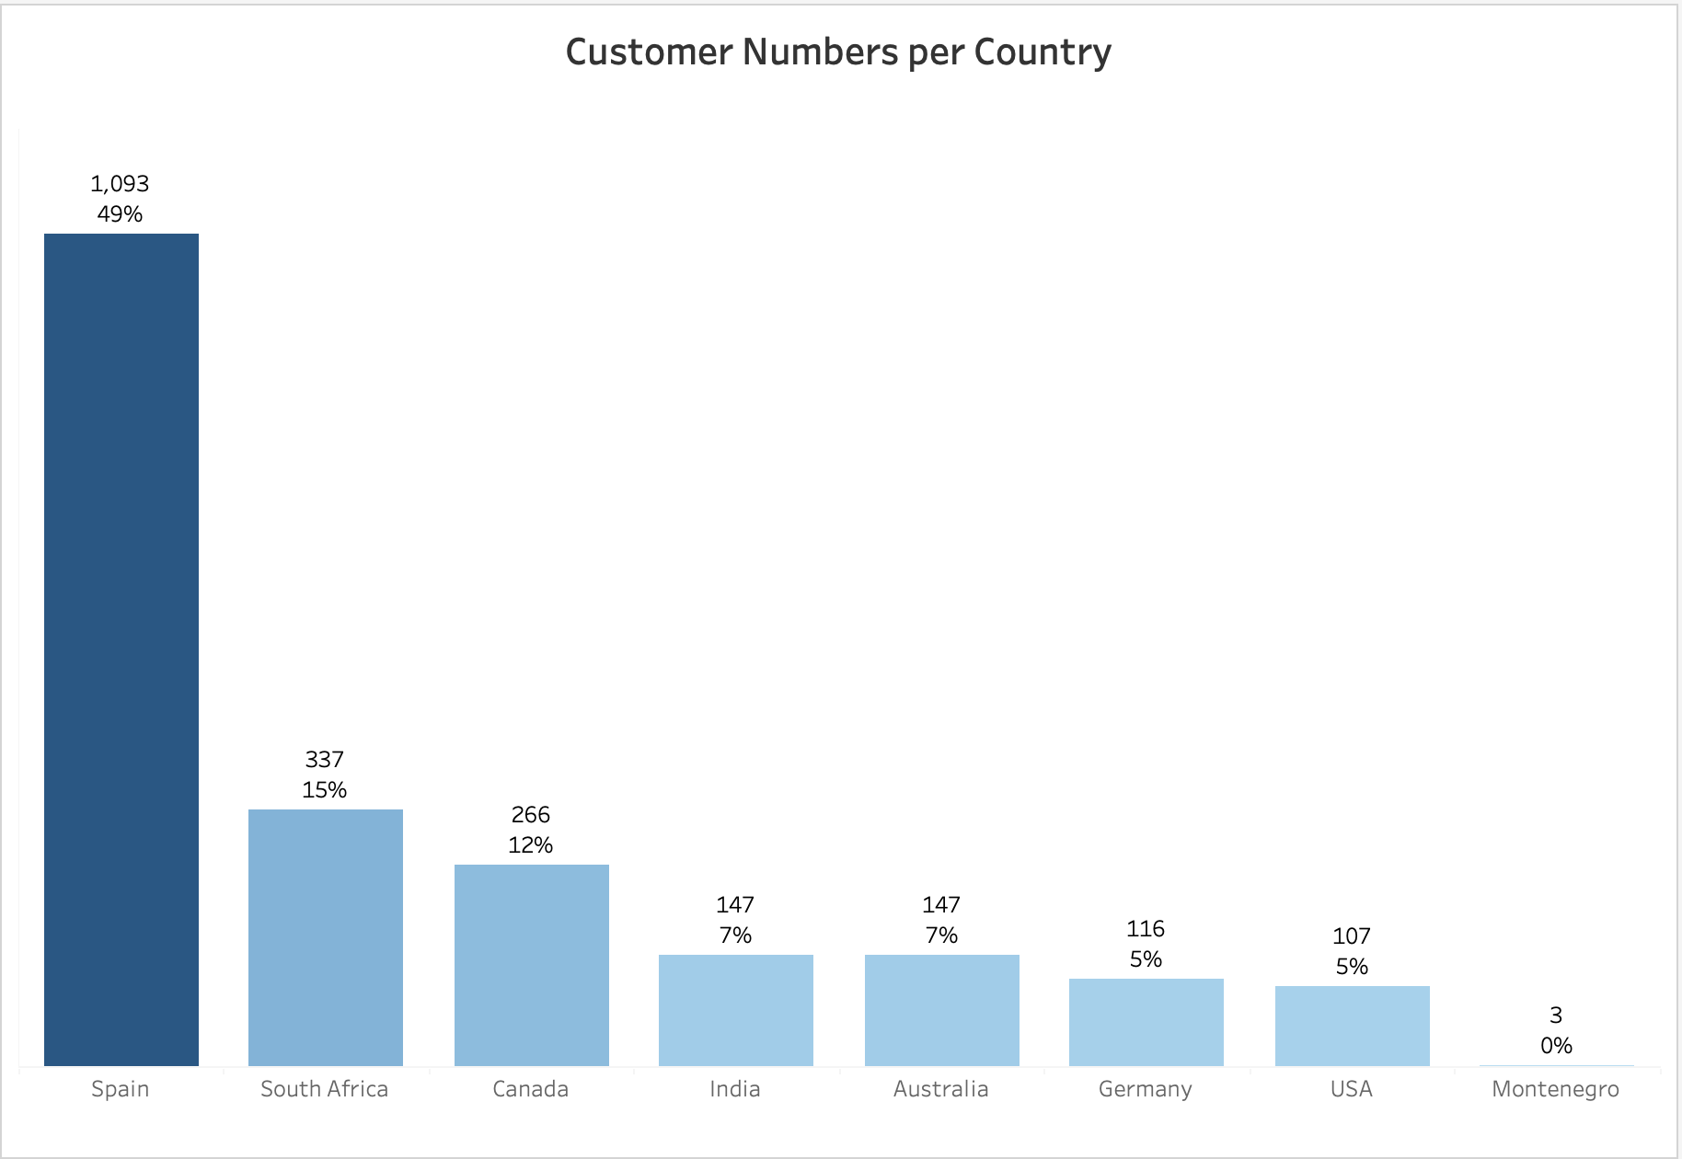
The Dataset Heavily Skewed Towards Spain
Notes:
It needs to be mentioned that the dataset was heavily skewed towards Spain, which accounted for half of all customers. South Africa and Canada contributed 15% and 12%, respectively, while other countries had even fewer shoppers, with Montenegro represented by just 3 individuals.
As such, Montenegro should be excluded from country-specific analysis.
It was not clear, but such imbalance may have stemed from data collection methods, perhaps business strategy at the time, or certain market characteristics.
Notwithstanding, it warrants further investigation.

Slide 3
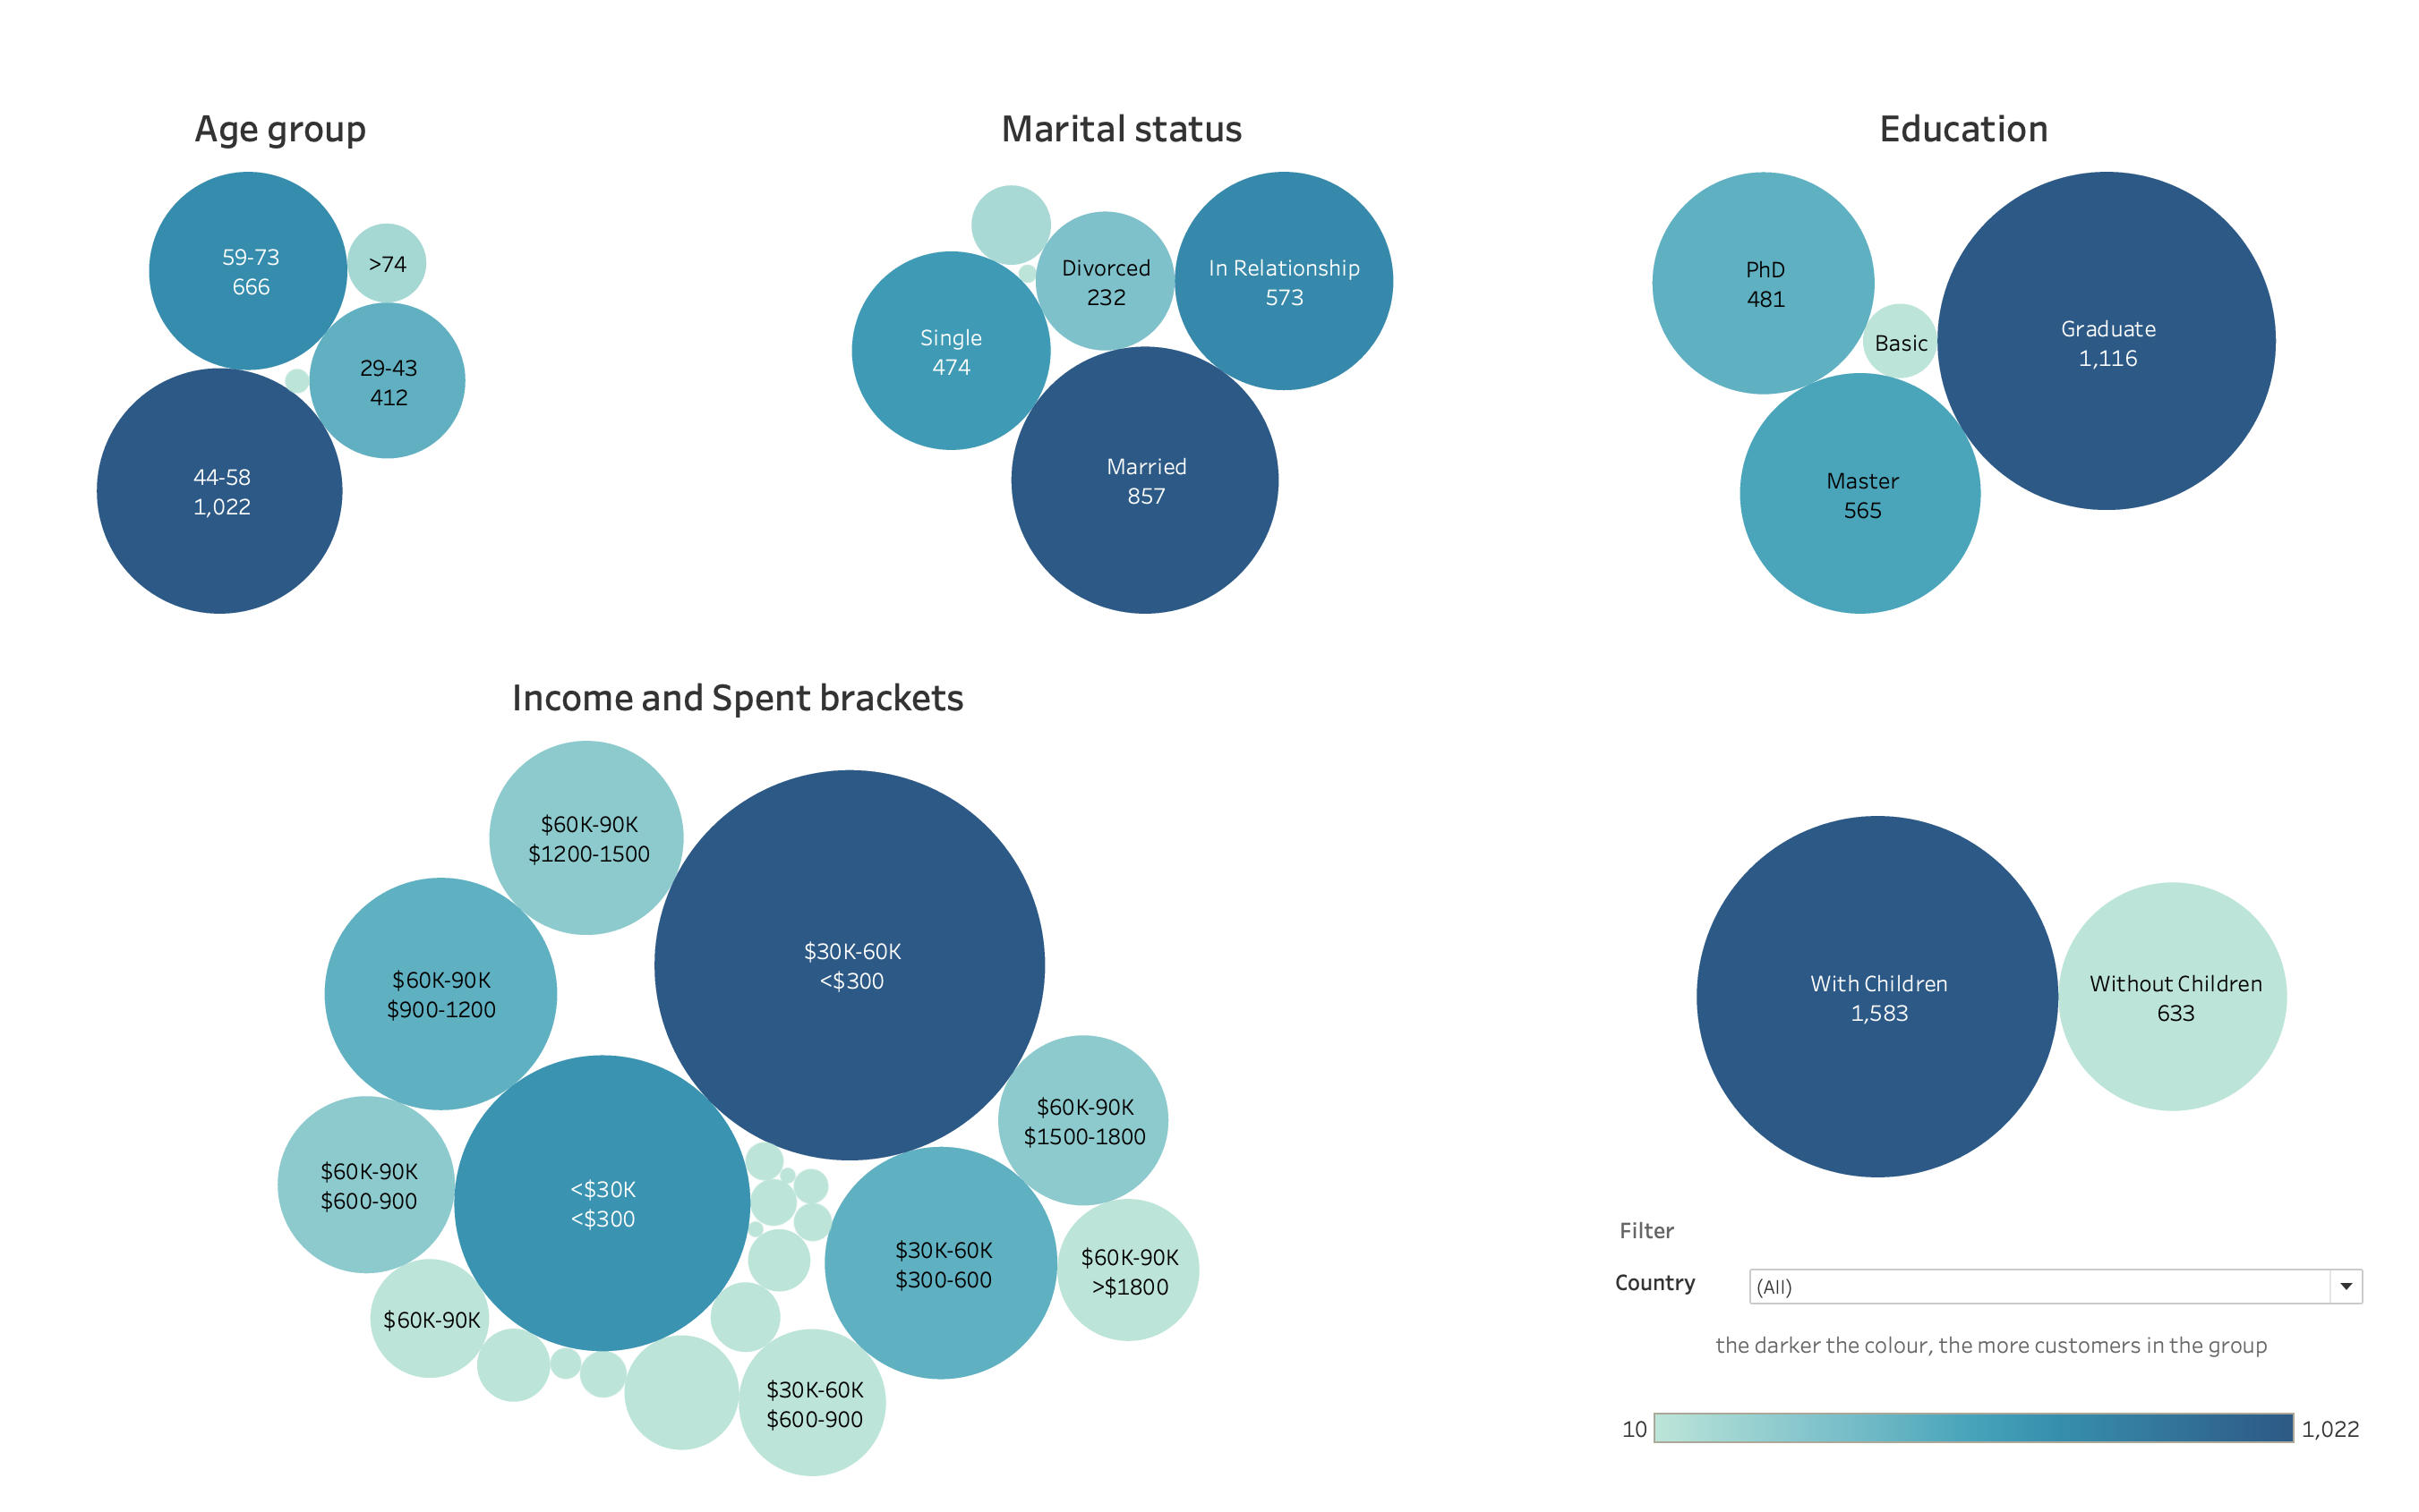
The Customer
Notes:
Moving on the customer dashboard
The largest group in each demographic is expressed by the darkest blue & the biggest bubble. therefore
typical 2Market customer
falls into the 44-58 years of age group, is married or in a relationship, has got children, and holds at least one degree.
He or she earns around $50,000 annually and spends, on average, less than $300.
This pattern is consistent across all countries, bar for Montenegro.

Slide 4
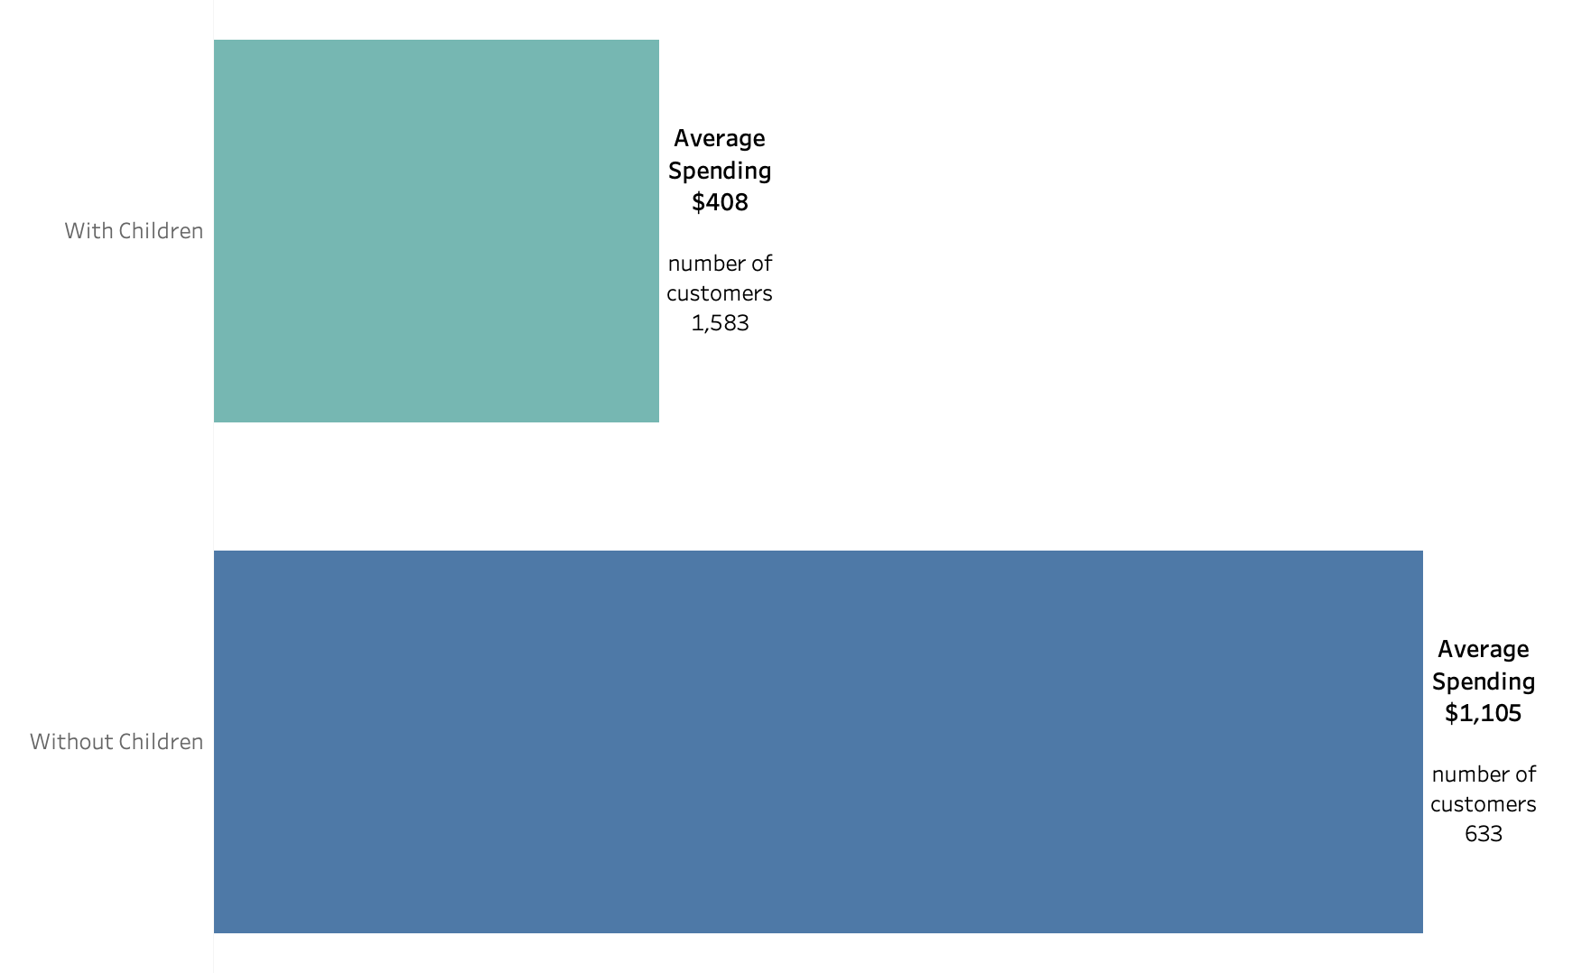

Impact of Children on Sales
Notes:
In terms of spending,
no demographic factor had a greater impact on average sales of majority of products and across all channels than whether customers had children.
Shoppers without children tended to spend more freely, while those with children were far more cautious.

Slide 5
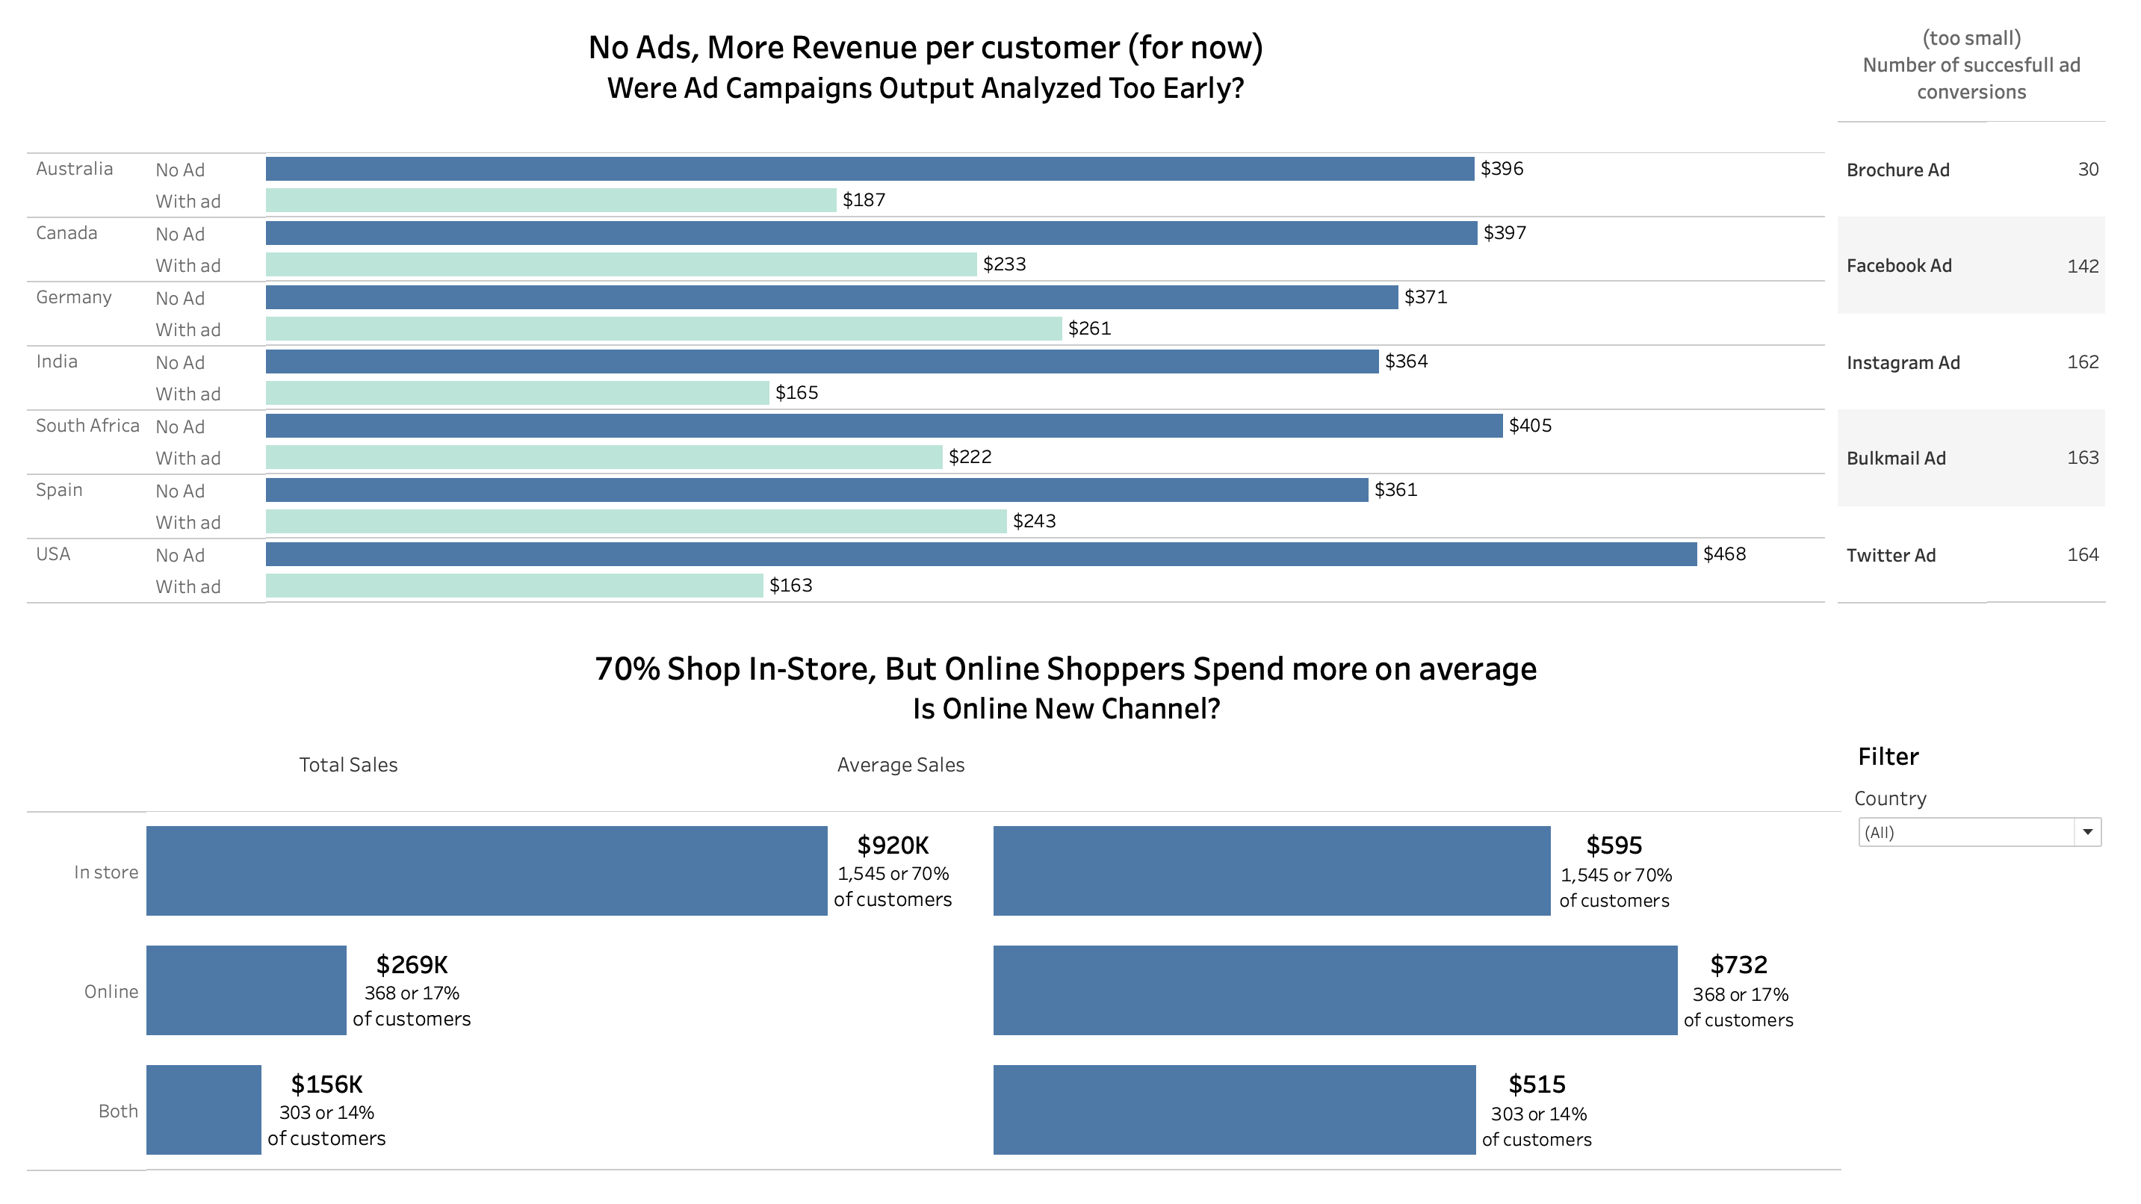
Advertising & Multichannel Retail
Notes:
Advertising question,
it's important to note that the data wasn't extensive enough to fully assess the effectiveness of each channel, therefore I opted to compare average sales from customers who encountered ads against those who did not.
And at this stage, perhaps erroneously due to unknown length and scope of the marketing campaingns - very low count of successful convertions point to perhaps premature attempt to draw conclusions, it is only clear that in all countries customers who were not exposed to ads tended to spend more on average.
Another key observation that warrants further investigation is the online/in-store shopping divide. A significant 70% of customers shopped in-store, while only 17% preferred online.
While in-store shoppers accounted for a larger share of total sales, online shoppers spent 23% more on average.

Slide 6
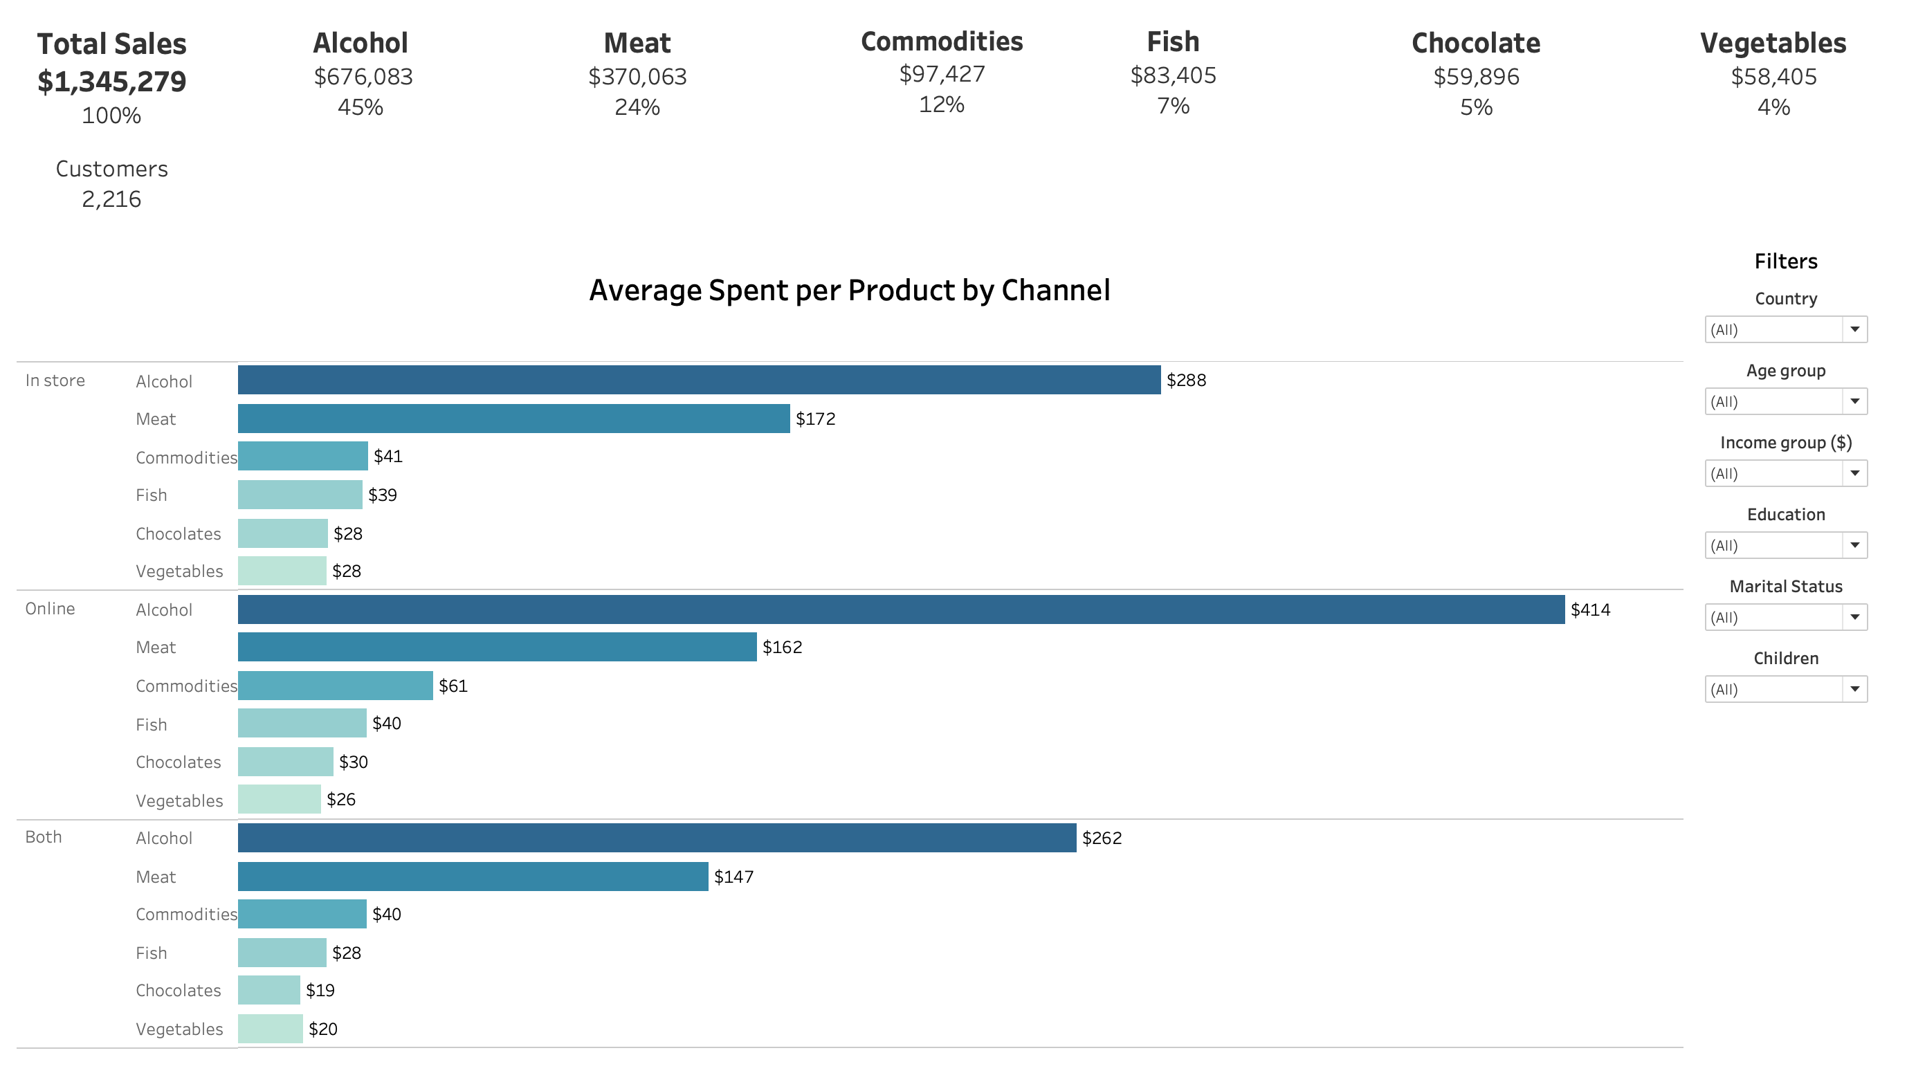

Products
Notes:
On the product front, limiting factor was the absence of unit sales and pricing data. Nonetheless, alcoholic beverages emerged as the top-selling category based on total and average sales, followed by meat. Other product categories contributed significantly less. This trend held across most demographics and countries. Notably, dairy products were missing from the dataset, which may have skewed product distribution analysis.

Slide 7
To Conclude
In light of the limitations identified in the dataset during the analysis, I would suggest further investigation once the following issues are addressed:
Increase and balance the size of customer samples from the countries in question,
Introduce a framework to capture additional data necessary for understanding the relationship between product price and sales volume,
Refine advertising campaigns to ensure the required data is captured,
Incorporate data from missing product categories (e.g., dairy) to provide a more comprehensive view of inventory
Notes:
and finally
it would be prudent

